Slide 1
Dolutegravir in PEPFAR
Heather Watts MD
Director of HIV Prevention, Program Quality Team
Office of the Global AIDS Coordinator

Slide 3
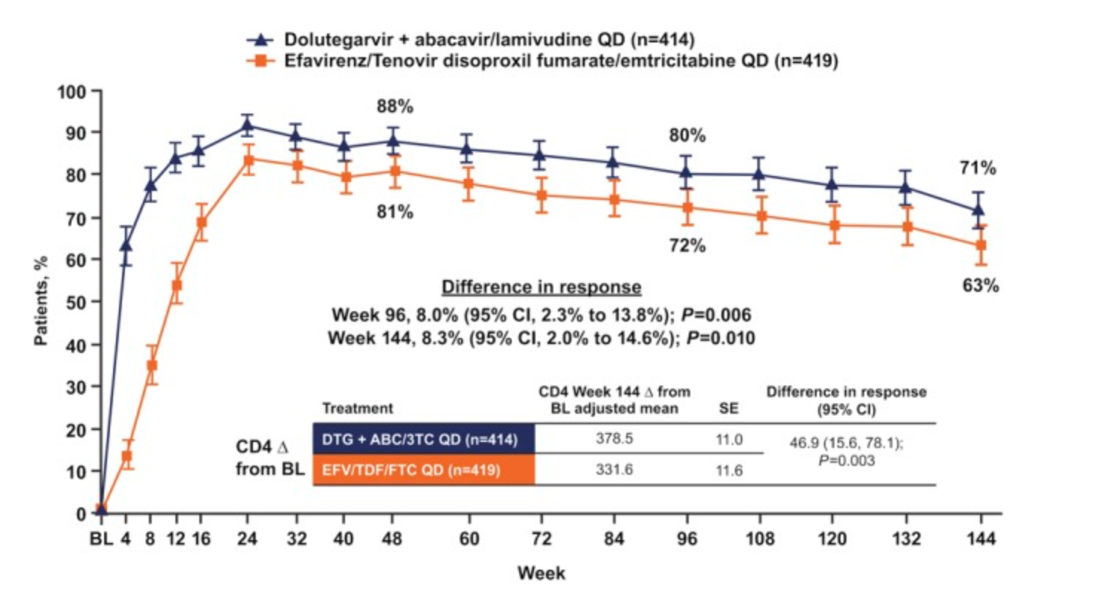
HIV RNA < 50 copies/mL and CD4 response in the SINGLE trial J Acquir Immune Defic Syndr 2015 Dec 15; 70(5): 515–519

Slide 4
NAMSAL HIV RNA Suppression at Week 48 (ITT)

Slide 5
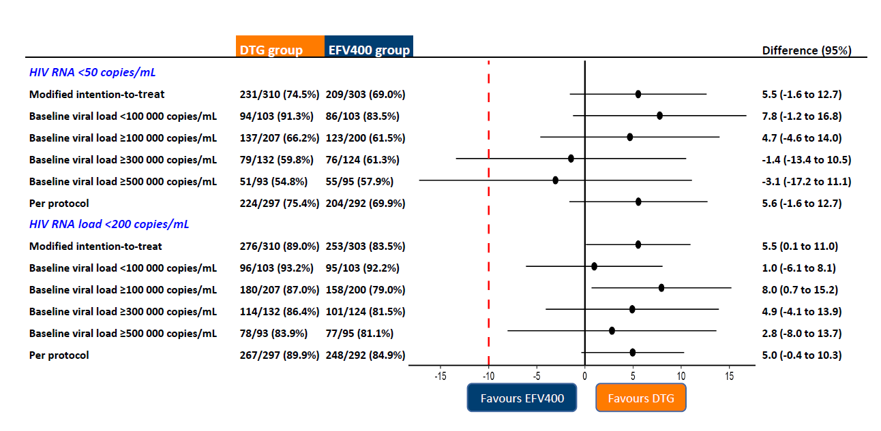
48 week outcomes in NAMSAL

Slide 7
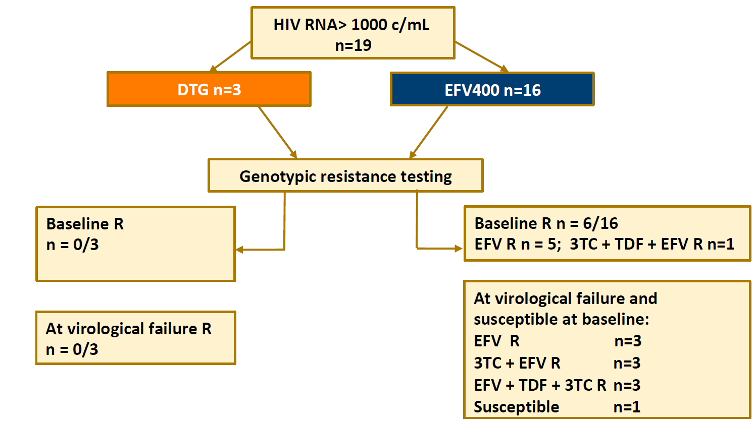
Emergence of resistance significantly more frequent in the EFV400 mg arm in NAMSAL

Slide 8
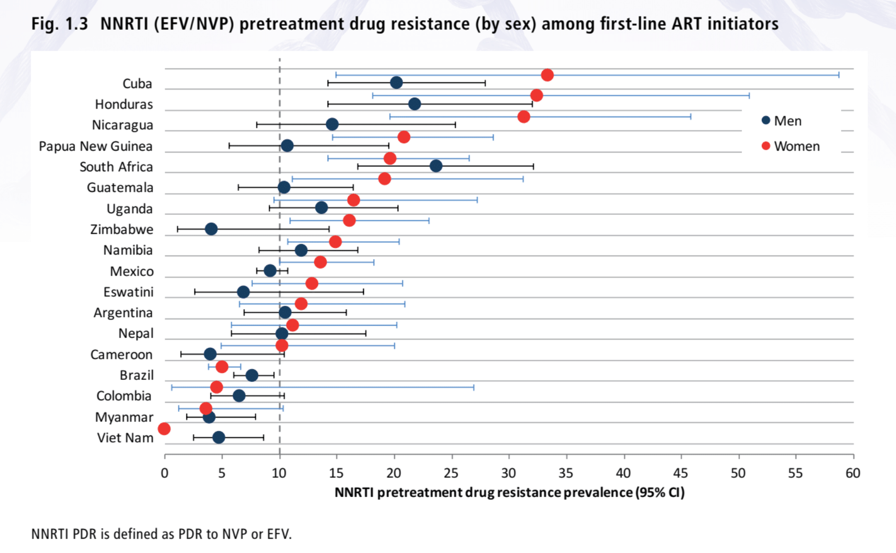
Pre-treatment drug resistance was > 10% among women in all African countries with results (WHO 2019 report, testing 2014-18)

Slide 9
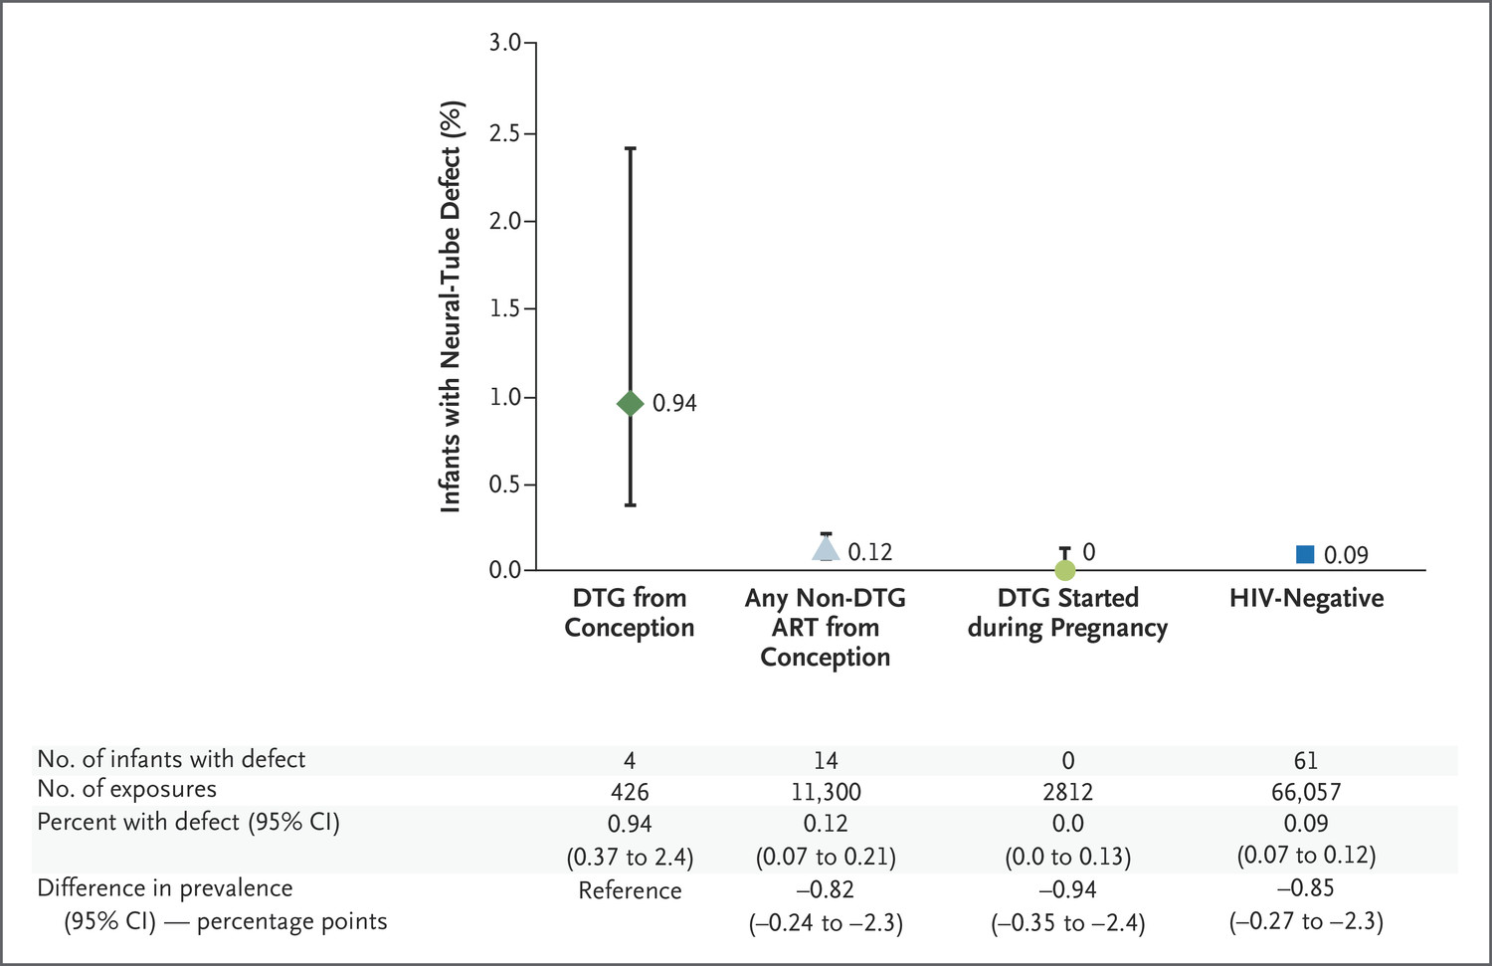
R Zash et al. N Engl J Med 2018;379:979-981.
Neural-Tube Defects in Infants According to Maternal ART Exposure Group and HIV Infection Status.
Dolutegravir at conception
Neural tube defects in 4/426 pregnancies
(0.94%, 95% CI 0.37-2.4%)
Updated data at IAS 2018:
4/596 (0.67% CI 0.26-1.7%) Zash TUSY15
Updated data at IAS 2019: 5/1683, 0.30% (95% CI 0.13, 0.69)
Notes:
Figure 1. Neural-Tube Defects in Infants According to Maternal ART Exposure Group and HIV Infection Status. There were 7 additional infants with neural-tube defects in the full cohort: 3 born to women who started non–dolutegravir (DTG) antiretroviral therapy (ART) during pregnancy, 3 to human immunodeficiency virus (HIV)–infected women who did not receive ART during pregnancy, and 1 to a woman of unknown HIV infection status who did not receive ART. Among the women who had been receiving any non-DTG ART at conception, 5675 were receiving tenofovir–emtricitabine–efavirenz, 1446 tenofovir–emtricitabine–nevirapine, 2439 zidovudine–lamivudine–nevirapine, 452 tenofovir–emtricitabine–lopinavir–ritonavir, 312 zidovudine–lamivudine–lopinavir–ritonavir, 242 other specified ART regimens, and 734 unspecified non-DTG regimens. Among the women receiving DTG treatment that was started during pregnancy, the median gestational age at the initiation of ART was 19 weeks (interquartile range, 14 to 25), and there were 75 women who started ART at a gestational age of less than 6 weeks.

Slide 11
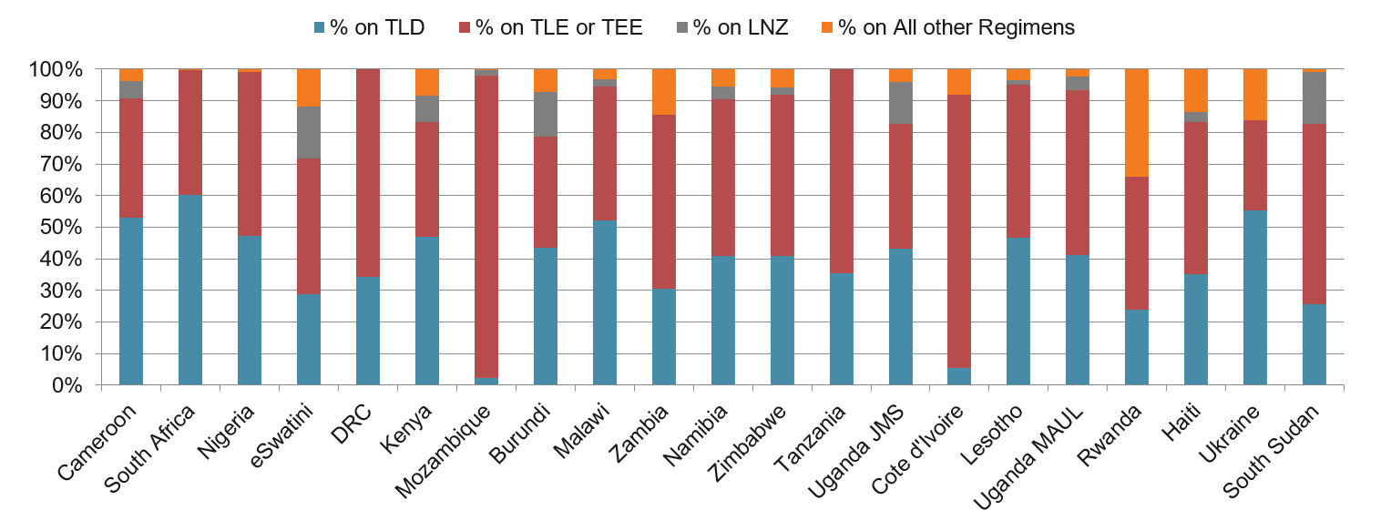
Impact of the Safety Report on TLD Rollout: % of Adult ART Patients per Country on ARV Regimens
February 2018
February 2018
After June GL
Notes:
Post COP18 planning meeting, countries submitted TLD transition plans that included greater than 75% of their current patients transitioning to TLD. These plans also included Naïve patients as part of the transition and the majority of these countries planned to target these patients first. The dolutegravir safety notice has had a significant impact on these original transition plans and will be demonstrated in the next slide.

Slide 12
How to weigh superior tolerability, efficacy, and resistance profile for DTG versus potential NTD risk?

Slide 13
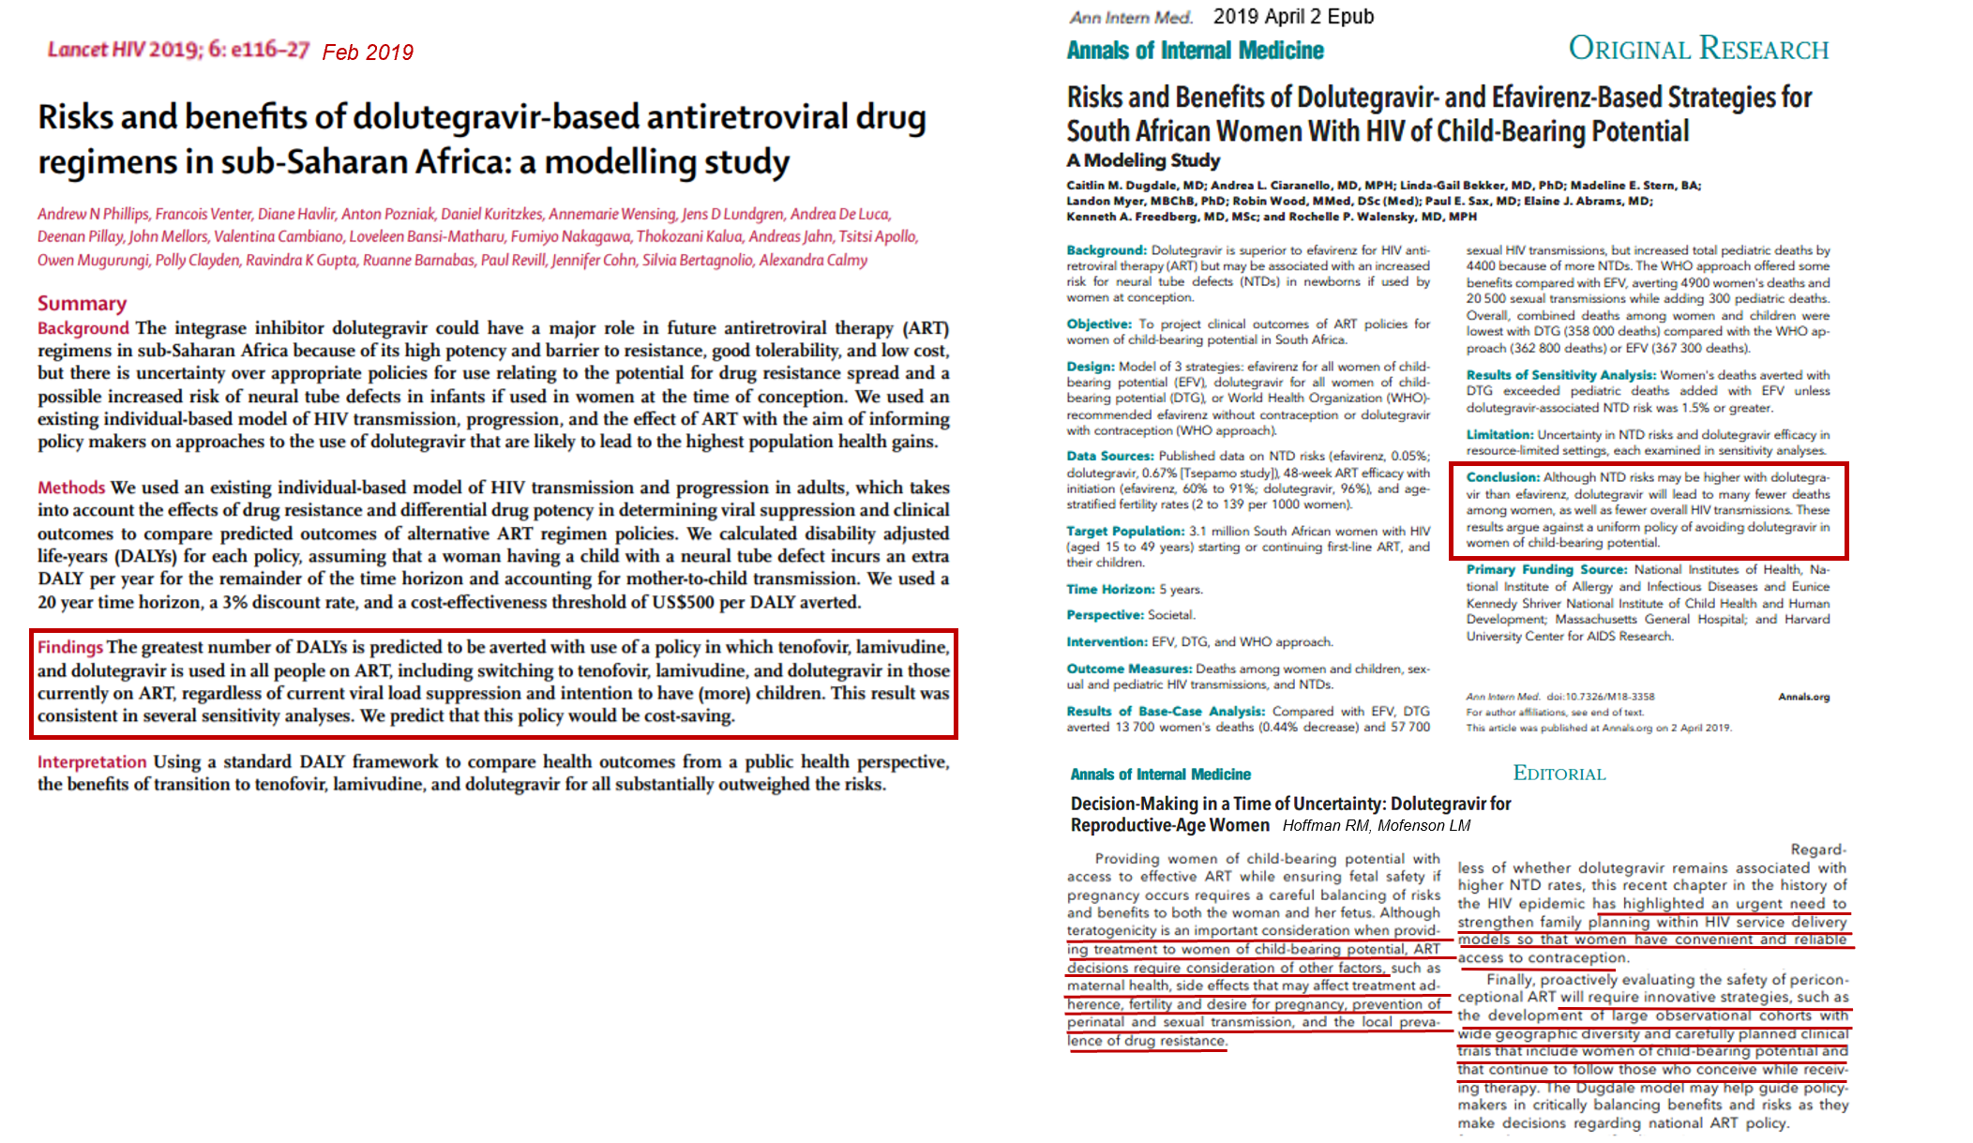
Modeling to Evaluate Risks and Benefits of DTG

Slide 14
Risks and benefits of dolutegravir-based antiretroviral drug regimens in sub-Saharan Africa: a modelling study Phillips et al Lancet HIV 2019 Feb; 6(2): e116–e127.

Slide 15
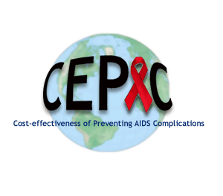
Modeled strategies comparing outcomes for women and infants Dugdale et al. Ann Int Med 2019;apr 2, epub ahead of print
Three strategies for first-line ART for 3.1 million women of childbearing potential living with HIV in South Africa, 5 year period:
Efavirenz (EFV) for all: Initiation of or continuation of efavirenz-based ART
Dolutegravir (DTG) for all: Initiation of or switch to dolutegravir-based ART
WHO Approach (WHO): Efavirenz without reliable contraception or dolutegravir with reliable contraception
Weighted average of EFV and DTG strategies based on contraception uptake and failure rates
Notes:
In this analysis, we modeled three strategies for first-line ART for women of childbearing potential in South Africa. In the efavirenz strategy, we modeled initiation of or continuation of efavirenz-based first-line ART for all women of childbearing potential. In the dolutegravir strategy, we modeled initiation of or switch to dolutegravir-based ART for all women of childbearing potential. In the WHO Approach strategy, women used first-line efavirenz-based ART if they were not using reliable contraception and dolutegravir-based ART if they were using reliable contraception. Outcomes for the WHO Approach strategy were a weighted average of outcomes of the EFV and DTG strategies based on age-stratified contraception uptake and method-specific failure rates.

Slide 16
Three-way pair-wise comparisons between strategies
Outcome* | DTG-EFV | Δ WHO-EFV | Δ DTG-WHO
Outcomes among women
Number of deaths among women | -13,700 | -4,900 | -8,900
Sexual transmissions | -57,700 | -20,500 | -37,300
Outcomes among children
Non-neural tube defect-related pediatric deaths | -2,100 | -100 | -1,900
Neural tube defects | +6,400 | +400 | +6,000
Pediatric HIV infections | -7,100 | -400 | -6,700
Children alive and HIV-free | +3,000 | +200 | +2,800
Cumulative pediatric deaths** | +4,400 | +300 | +4,100
Combined outcomes among women and children
Cumulative deaths among women and children | -9,300 | -4,500 | -4,800
*Out of projected 3.7 million women ever on first-line ART and 1.2 million HIV-exposed children.
**Cumulative pediatric deaths = non-neural tube defect-related + neural tube defect-related deaths
Dugdale et al. Ann Int Med 2019;apr 2, epub ahead of print
Notes:
We also performed pair-wise comparisons between the WHO Approach and the efavirenz and dolutegravir strategies. In these comparisons, we present the differences (the deltas) between strategies rather than the absolute numbers. Here, outcomes that favor dolutegravir are again in red and those that favor efavirenz are again in blue. The outcomes that favor the WHO Approach in each pair-wise comparison are in purple. For outcomes among women, the WHO Approach performed more favorably than efavirenz, but not as favorably as the dolutegravir strategy. Compared to efavirenz, the WHO Approach averted 11,200 deaths among women. However, dolutegravir reduced deaths among women by 20,400 compared to the WHO Approach.

Slide 17
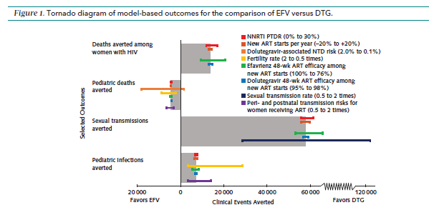
Model-based Outcomes Comparing EFV (favored to left) and EDT (favored to right)

Slide 18
The rate of NTD’s would need to be 1.5-1.8% (15-18/1,000 versus 3/1,000 in current report) to offset benefits of DTG over EFV for maternal health, depending on rate of pretreatment NNRTI resistance
Black X= July, 2018 rate, white X= May, 2018 rate, white star July, 2019 rate = 0.3%
Dugdale et al. Ann Int Med 2019;apr 2, epub ahead of print

Slide 19
Summary
Many more deaths in women of childbearing potential, sexual transmissions, and perinatal transmissions would be averted than neural tube defects occurring with a strategy of DTG for all.
Excess deaths on EFV increase as the rate of pretreatment NNRTI drug resistance increases.
Women should be counseled regarding benefits and risks to allow informed decision making.
Contraception should be available to women who desire it but should not be a condition for DTG prescription.

Slide 20
Conclusions
PEPFAR remains committed to broad implementation of DTG-based regimens as first and second line treatment as required in COP19 guidance.
We continue to work closely with our country teams to advocate for broader availability of DTG for women and to provide resources for implementation.
The community of women living with HIV must be included in decision making at every level.
We support integration of reproductive health services into HIV care.
PEPFAR is supporting multiple efforts to obtain additional data on BD risk and supporting ongoing birth defect surveillance in Uganda and Malawi.

Slide 21
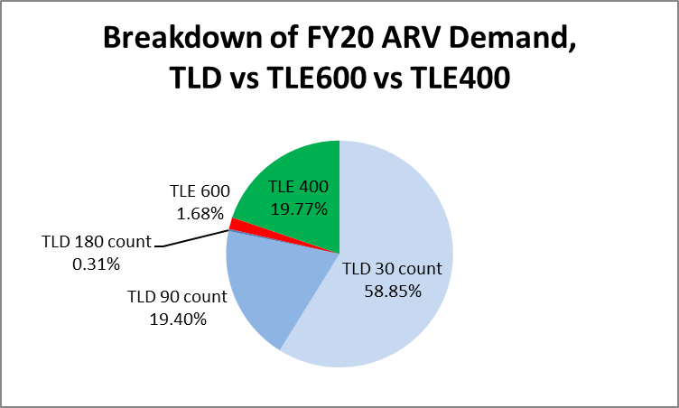
Adult 1st-Line ARV Global Demand in PEPFAR Countries

Slide 22
Thank You

